Slide 1
My bedroom
Spotlight 5
Module 3
3 с
Подготовила: Шилова И.С.

Slide 2
Phonetic practice:
[θ] fifth, sixth, seventh, eighth, ninth, tenth, three
[ð] the, this, those, there
th
The kitchen is on the fifth floor.
This is the tenth floor.

Slide 3



Homework.
Is there
Yes, there is.
Are there
No, there aren’t. There is only one.
No, there aren’t. There are two.
WB p. 30 ex. 3
Yes, there are two lamps in the room.
No, there isn’t.
Yes, there is one.

Slide 4






Prepositions of place.

Slide 5
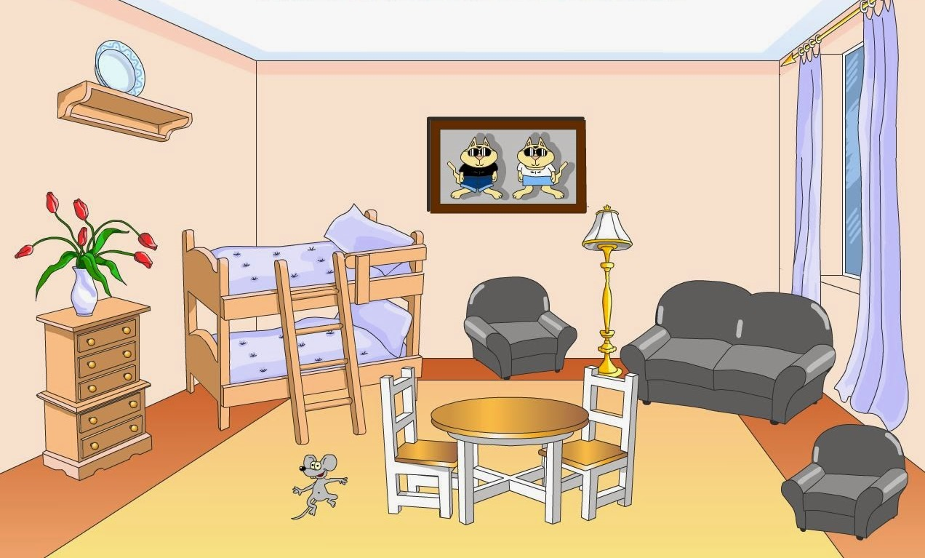
A: Where is the shelf?
B: It is on the wall.

Slide 6

Listening.
WB p.31 ex. 3
˅

Slide 7
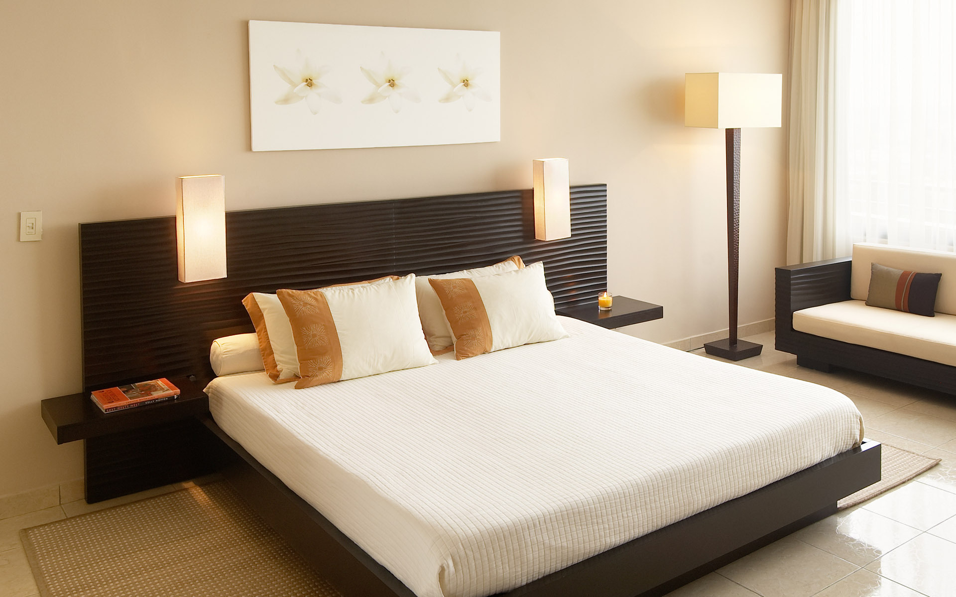
Reading.
SB p.50 ex. 2

Slide 8
Do the crossword.
F | R | I | D | G | E | S | O | G | W
W | J | U | T | B | E | D | L | B | I
B | O | O | K | C | A | S | E | A | N
A | R | U | N | M | E | O | L | V | D
T | U | C | A | R | P | E | T | I | O
H | E | O | K | F | D | B | Y | O | W
A | M | I | R | R | O | R | P | D | C
M | B | R | Y | C | O | O | K | E | R
P | A | I | N | T | I | N | G | S | I
H | A | L | L | A | S | I | N | K | R

Slide 9

Your Homework:
SB p.50 ex. 5
Write a paragraph describing your bedroom
(30-50 words)
Thanks for your attention!

