Slide 1
THE UNITED KINGDOM

Slide 2
Let’s read and learn new words: make a journey -путешествовать, Lochs – озера в Шотландии, the bagpipes – волынка (национальный музыкальный инструмент в Шотландии), kilts – национальная мужская одежда, rugby – национальная игра, have a nice trip – хорошей поездки, Irish - ирландский язык

Slide 3
The UK. Countries
England
Scotland
Wales
Northern Ireland

Slide 4
THE UK
Great Britain
The British Isles
Ireland

Slide 5
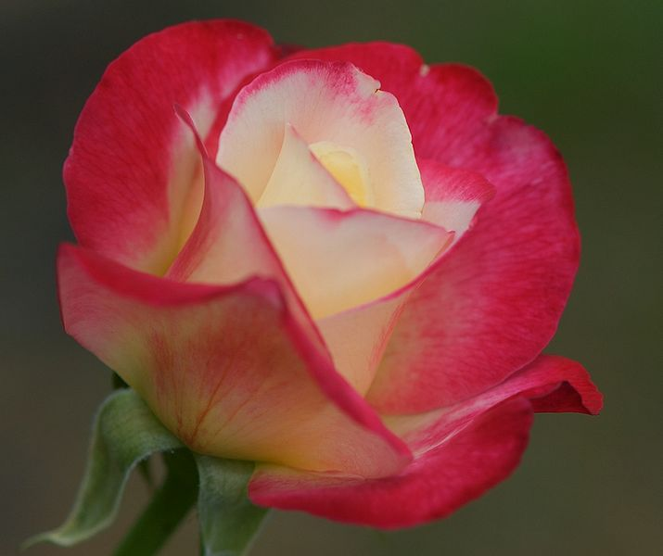
England.
The Capital is London
Rose

Slide 6
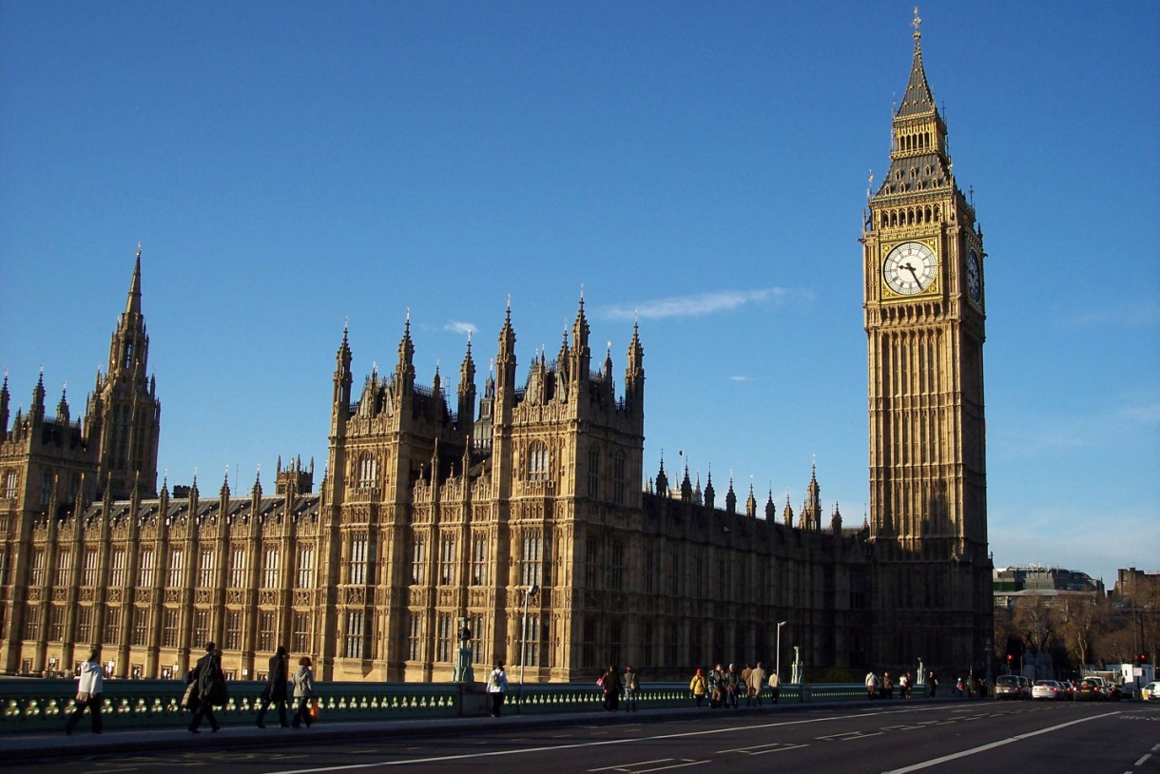
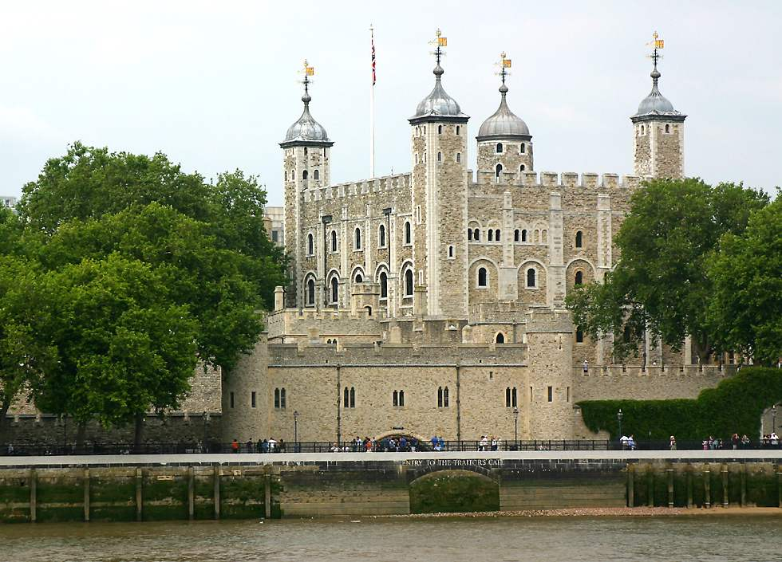
The 23rd of April – the national day of England.

Slide 7
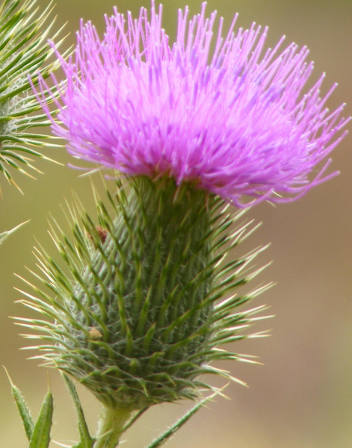
Scotland.
The Capital is Edinburgh
Thistle

Slide 8
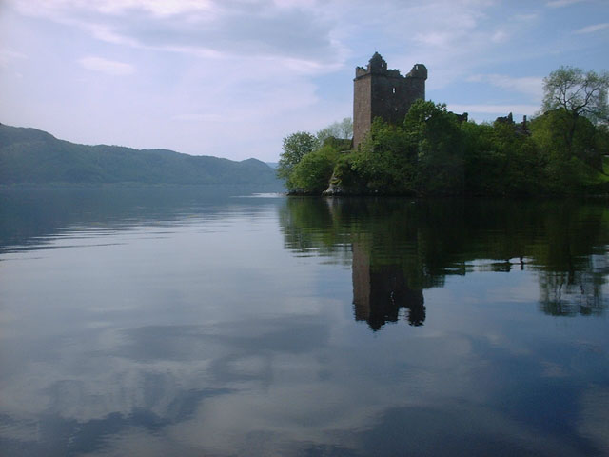
Loch Ness –
– the famous Scottish instrument is the bagpipes.

Slide 9
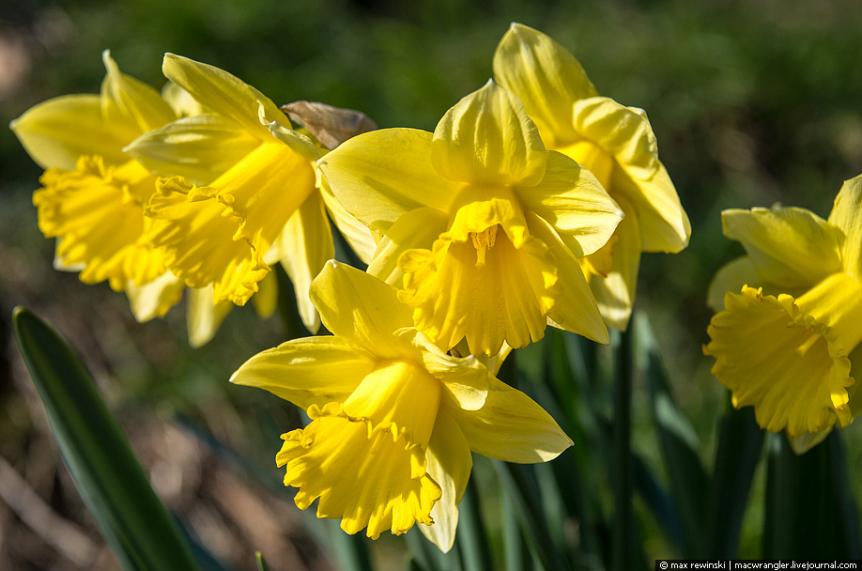
Wales
The capital is Cardiff
Daffodil
The 1st of March is the national day

Slide 10
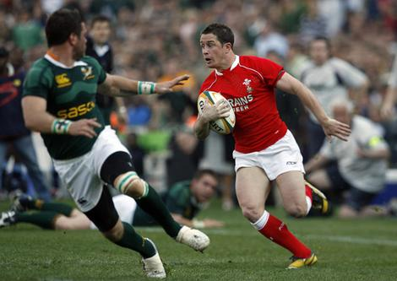
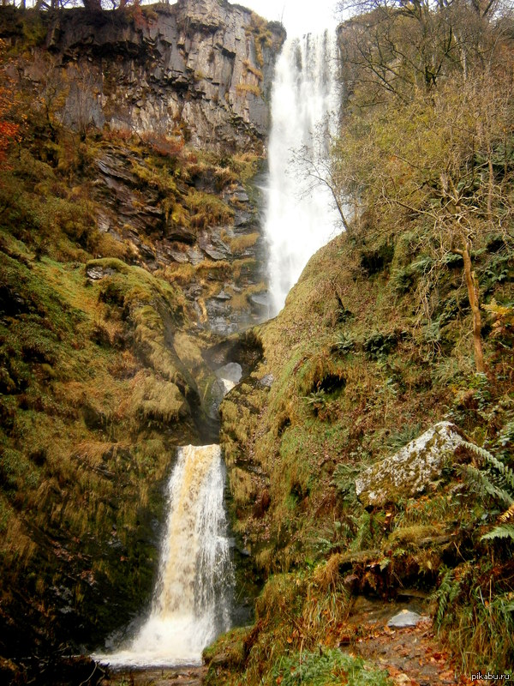
Rugby-
-Wales is a country of mountains and waterfalls

Slide 11
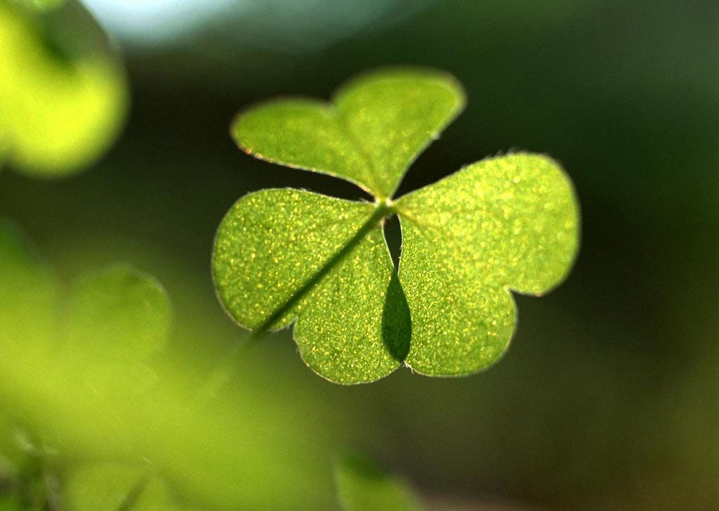
Northern Ireland
The capital is Belfast
Shamrock

Slide 12
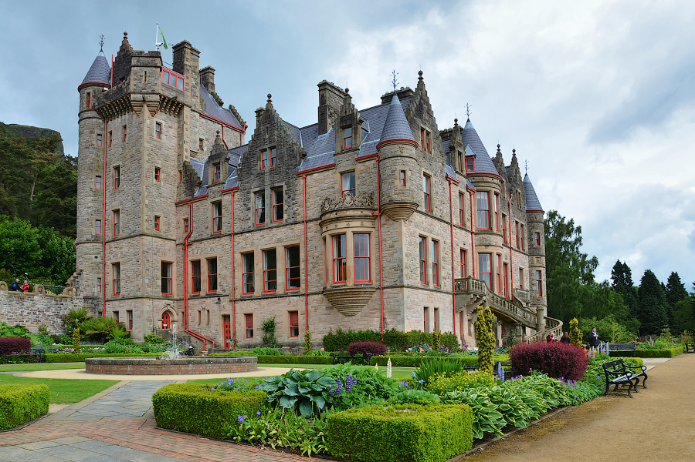
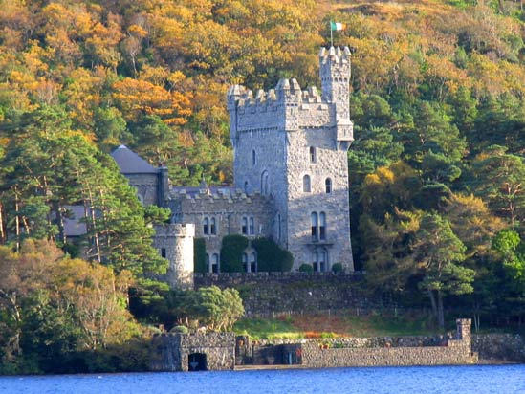
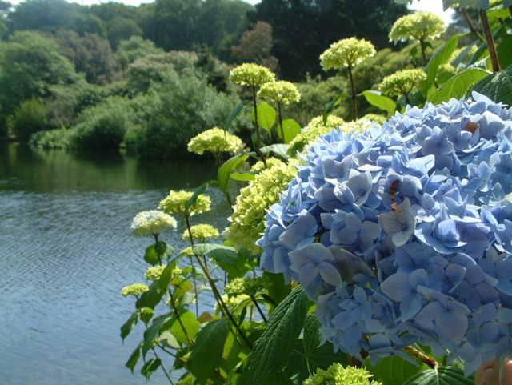
The country of ancient castles and gardens

Slide 13
 | 1. The UK
1. | Parts | a) 4
2. | Official language | a) English
3 | The t the name” United Kingdom” was first used . | a) in 1707
 | 2. England
1. | Capital | London
2. | The national symbols (flowers) | Rose
3. | National day | b) the 23rd of April
4. | Official language | English
 | 3. Scotland
1. | Capital | c) Edinburgh
2. | The national symbols (flowers) | thistle
3. | National instrument | Bagpipes
4. | Places of interest | Loch Ness
 | 4. Wales
1. | Capital | b) Cardiff
2. | The national symbols (flowers) | daffodil
3. | National day | the 1st of March
4. | National game | b) rugby
 | 5. Northern Ireland
1 | Capital | Belfast
2 | The national symbols (flowers) | b) clover
3 | National language | Irish and English

Slide 14
Match the questions and the answers:
What city is the capital of the
United Kingdom?
2. When was first used the name
“United Kingdom”?
3. English is the national language,
isn’t it?
4. Which country is rich in waterfalls?
5. Is the bagpipes an Irish instrument?
1. Yes, it is.
2. Wales.
3. London.
4. No, it’s Scottish one
5. In 1707

Slide 15
Thank you!
Goodbye!

